Slide 1

CAMERA DATASET
STATISTICS FOR DATA SCIENCE UE19CS203
TEAM MEMBERS:
NAME: SRN:
1. PHANI KUMAR VEDURUMUDI PES2UG19CS281
2. PAWAN PRASAD P PES2UG19CS280
3. RAHUL S BHAT PES2UG19CS315
4. PRATHEEK PES2UG19CS291

Slide 2
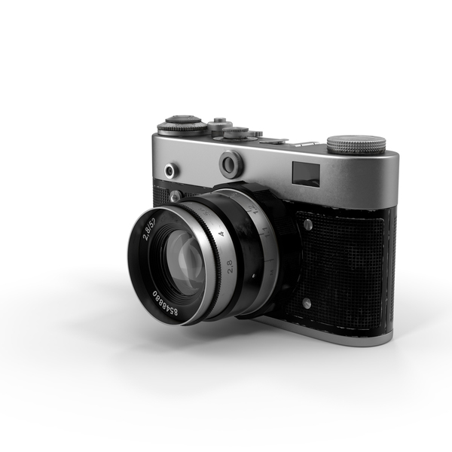
DATA SET SELECTION
CAMERA DATASET
Dataset name: camera_dataset
Source: Kaggle
No. of observations: 1038
Percentage of missing values: 5%

Slide 3
FEATURES
1.MODEL:
This feature of the dataset describes about the various models of the different type(company) of cameras present in the choosen dataset.
2.RELEASE DATE:
This feature of the dataset describes about the various release dates(in years)of the different models of the cameras in the dataset.
3.MAX RESOLUTION:
This feature of the dataset describes about the maximum resolution of the different models of the cameras present in the dataset.

Slide 4
4.MIN RESOLUTION:
This feature of the dataset describes about the minimum resolution of the different models of the cameras present in the dataset.
5.EFFECTIVE PIXELS:
This feature of the dataset describes about the different number of effective pixels of each camera model in the dataset.
6.ZOOM WIDE:
This feature of the dataset describes about the short focal length of the different cameras in the dataset.
7.ZOOM TELE:
This feature of the dataset describes about the long focal length of the different cameras in the dataset.
8.NORMAL FOCUS RANGE:
This feature of the dataset describes about the lens of the various cameras in the dataset with a focal length approximately equal to the diagonal of the film format or of a digital camera's image sensor. Most 35mm cameras normal lenses have a focal length of approximately 50 mm.
9.MACRO FOCUS RANGE:
This feature of the dataset describes about the focal length of the various cameras in the dataset, a macro lens (50 mm on a 35 mm camera) can focus so close that lighting remains difficult. Macro lens has a focal lengths from about 100 to 200 mm.

Slide 5
10.STORAGE INCLUDED:
This feature of the dataset describes about the inbuilt storage that is included in the various cameras of the dataset.
11.WEIGHT:
This feature of the dataset describes about the weight of the cameras(inclusive of the weight of the batteries)in the dataset.
12.DIMENSION:
This feature of the dataset describes about the dimensions of the cameras in the dataset.
13.PRICE:
This feature of the dataset describes about the prices of the cameras in the dataset.

Slide 6
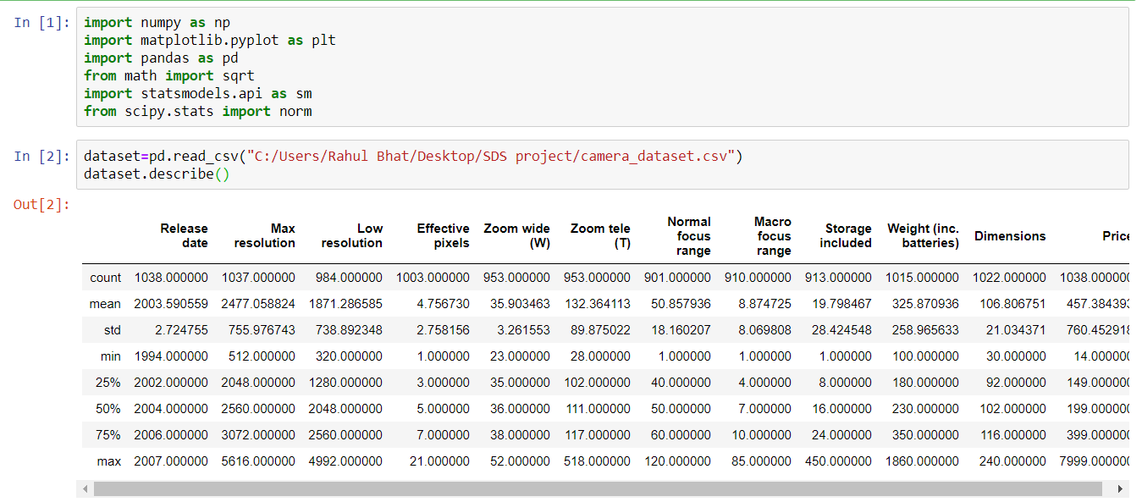
KNOWING YOUR DATASET

Slide 7
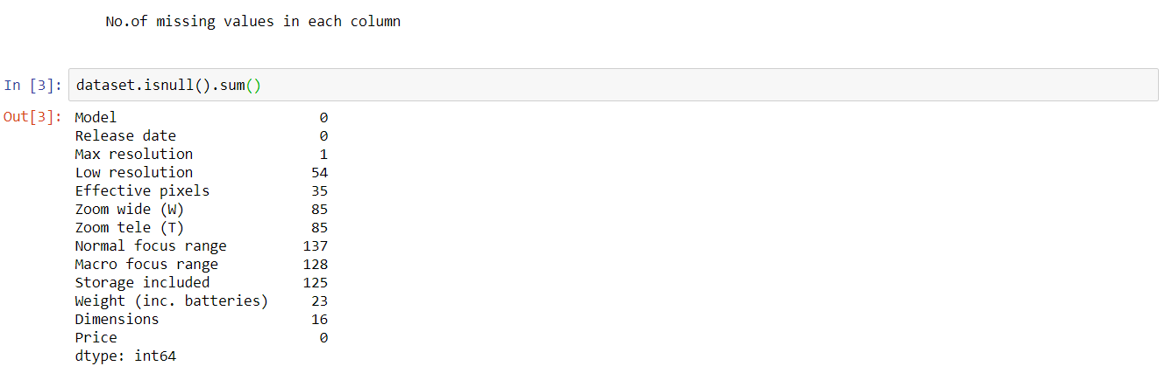
DATA CLEANING AND MISSING VALUE TREATMENT

Slide 8
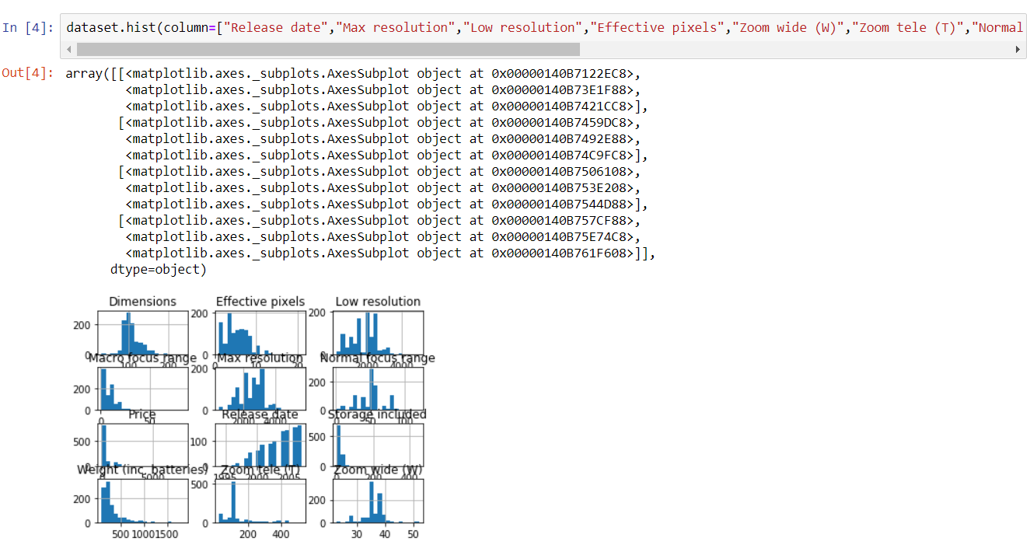

Slide 9
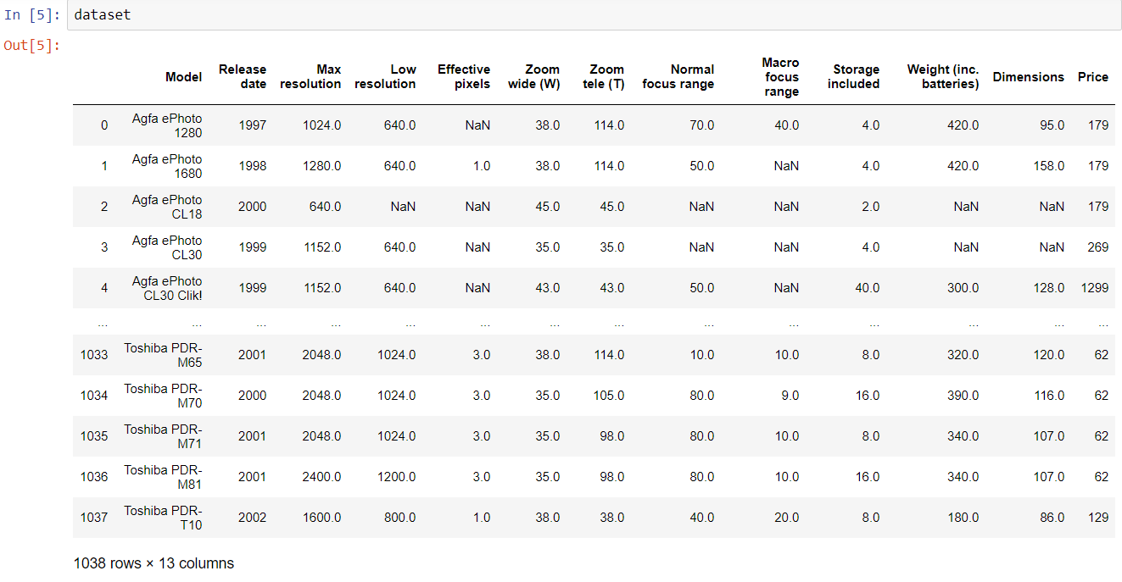
DATASET

Slide 10
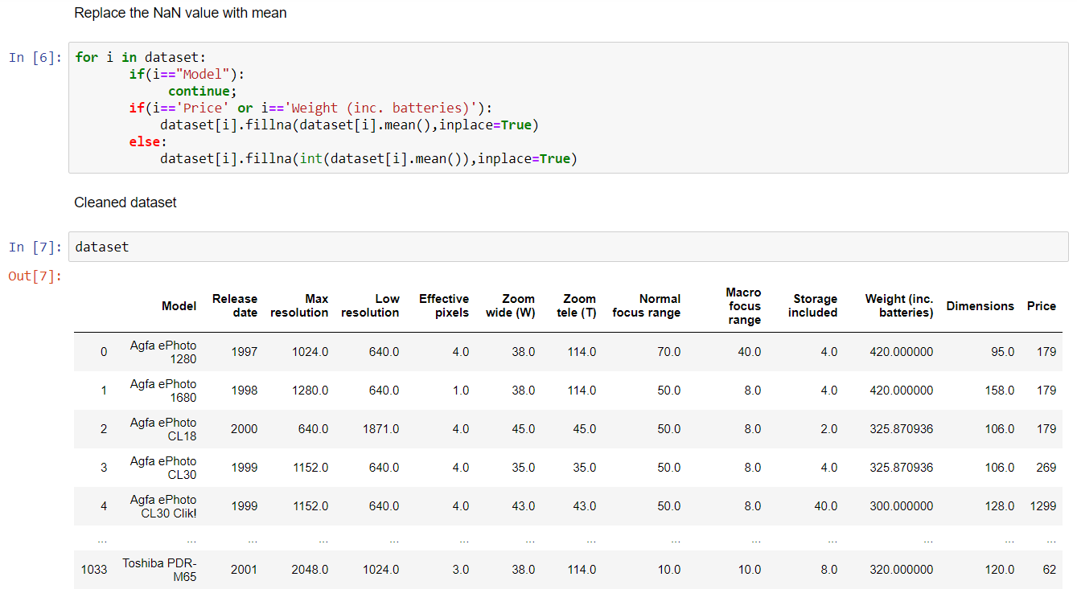

Slide 11
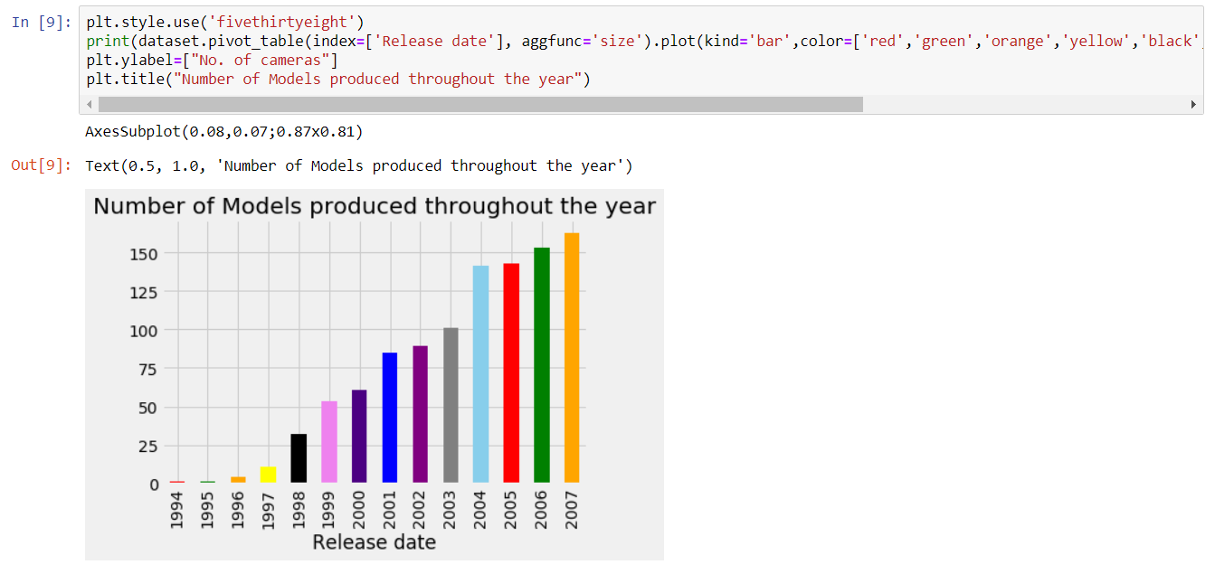
NUMBER OF MODELS PRODUCED THROUGHOUT THE YEAR

Slide 12
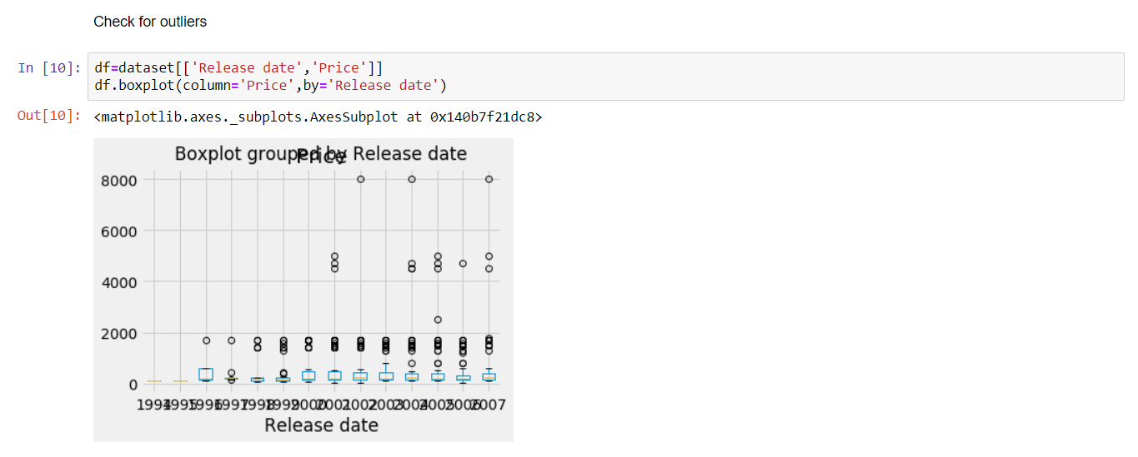
OUTLIERS

Slide 13
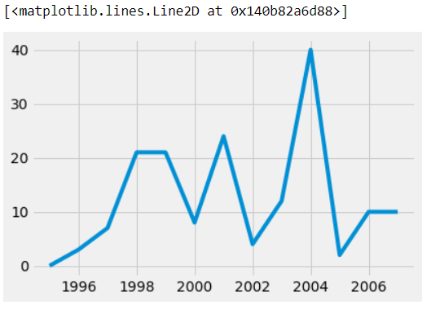
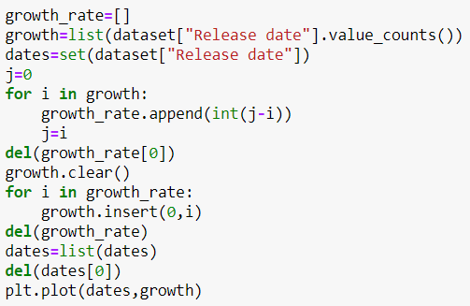
GROWTH IN PRODUCTION EACH YEAR

Slide 14
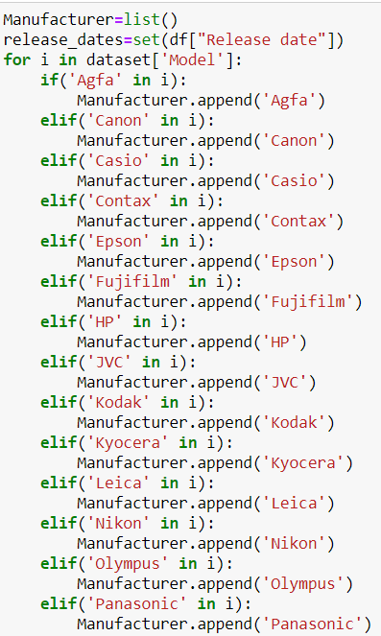
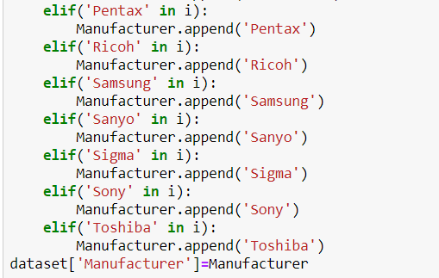
ADDING NEW FEATURE TO THE DATAFRAME

Slide 15
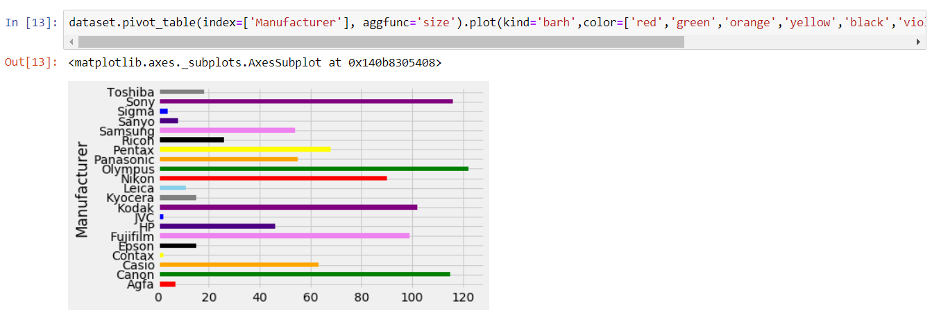
NUMBER OF MODELS MANUFACTURED BY EACH MANUFACTURER

Slide 16
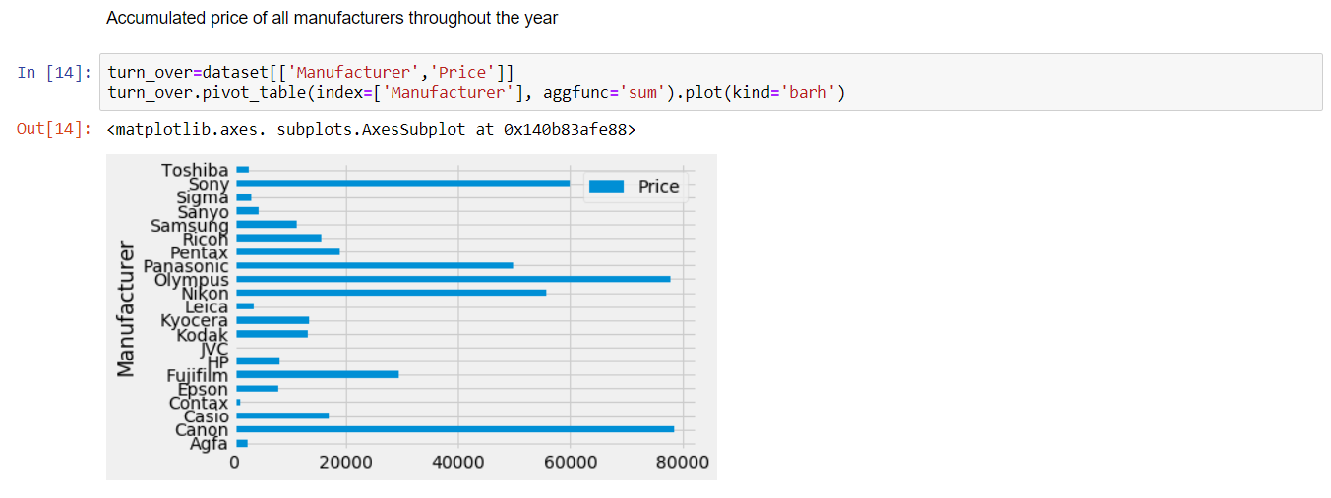
ACCUMULATED PRICE OF EACH MANUFACTURER

Slide 17
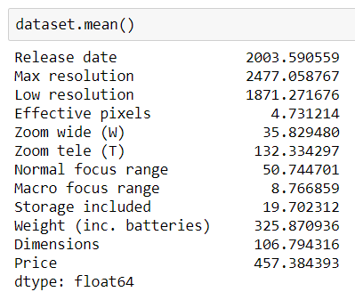
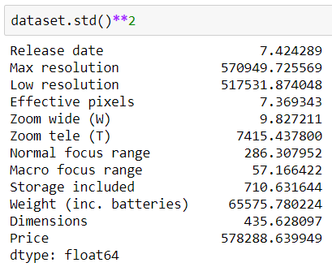
NORMALIZATION mean and variance of each column

Slide 18
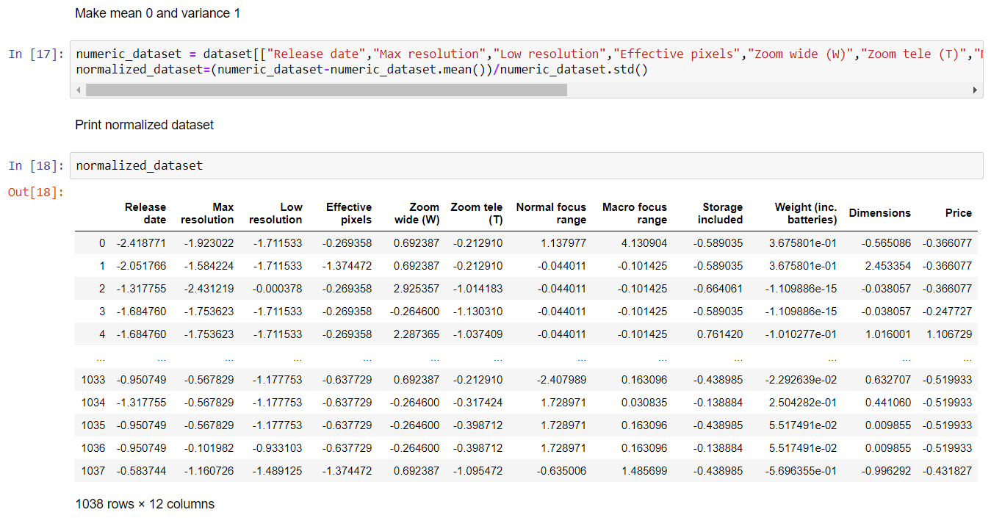

Slide 19
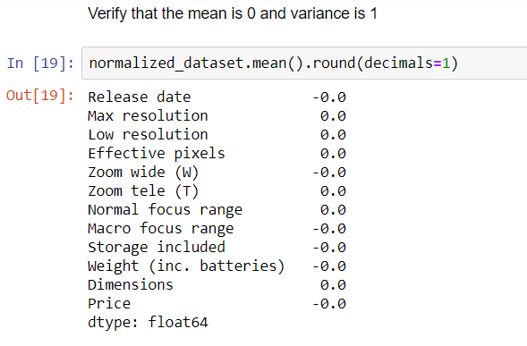
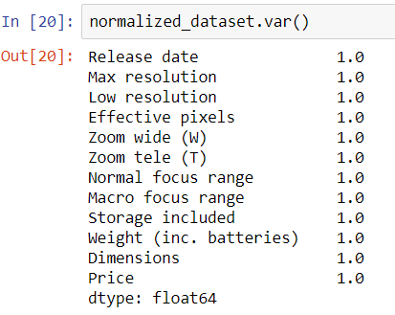

Slide 20
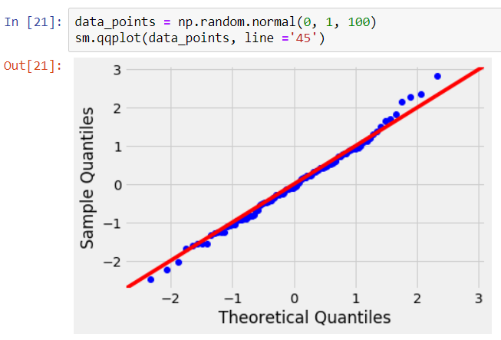

Slide 21
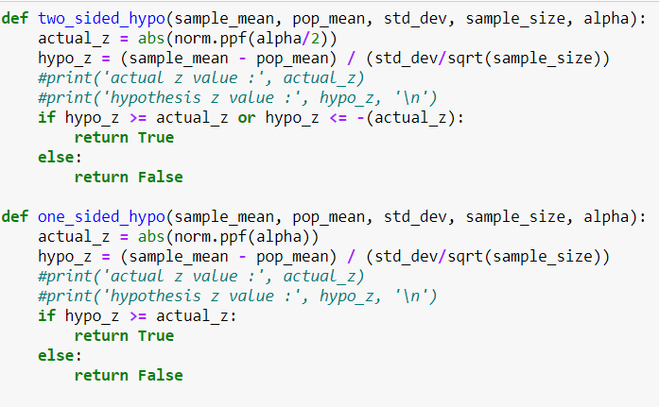
HYPOTHESIS TESTING

Slide 22
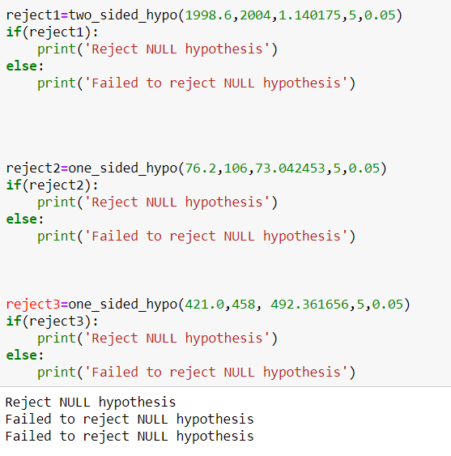

Slide 23
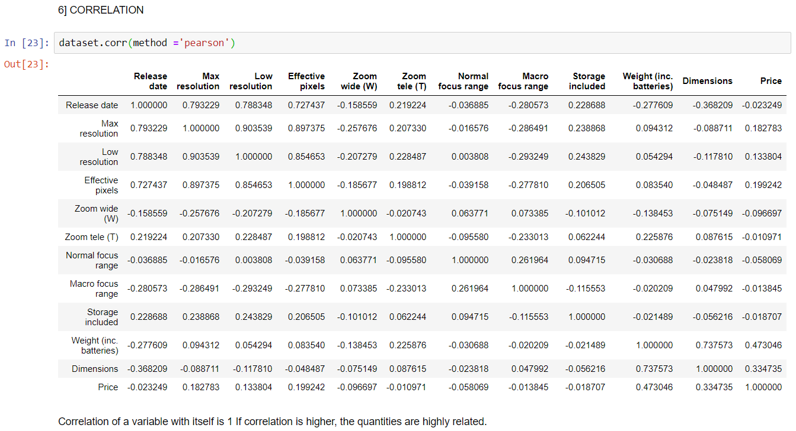
CORRELATION ANALYSIS

Slide 24
CONCLUSIONS
To summarize we first found a dataset consisting of 13 variables (features), 1038 rows and 5% missing values. We then performed data cleaning and fixed all typos, inconsistent, capitalization, etc. To further have a better understanding of the data we are dealing with, we plotted graphs like bar chart, histogram, box plot, line graph and scatter plot and analyzed the data to draw meaningful insights. We also filtered the outliers using the box plot method. We then applied normalization to remove data anomalies and standardized the columns on a common scale. We found that the data is normal using graphs. We then found the correlation to find out how the data are related to each other by plotting a scatter plot. We have also performed the three hypothesis tests as mentioned above. Hence from this analyzes we can conclude that the camera production has been raising up by every year and also there is a growth in the production.

